Slide 2
Sharp Health
September, 2023

Slide 3
Agenda
Picking up where we left off (<5 min)
What we discussed in the last meeting
4 use cases where EXL can and will support Sharp deliver on that goal and improve quality efforts
Focus on HEDIS Overread using NLP Engine
Detailed discussion on Abstraction and NLP Process
Member Outreach Strategy
Proposed items for discussion (~25 min)
Focus on the first use case and detailed discussion on:
Using NLP and AI to streamline HEDIS Chart Review & Abstraction processes
Demo of NLP in action
Campaign Outreach strategy using Next Best Action Framework
Wrap up & closing thoughts – Next Steps (<5 min)
How can EXL align to and participate in driving Sharp’s vision forward in 2023?
Second session on additional use cases of value for Sharp
CAHP in October (Dr. Shames)

Slide 4
Topics for discussion – 4 Use Cases to streamline and improve quality efforts
Use Case #1 - HEDIS overread using NLP engine
Using Machine Learning (ML), NLP can be used to review the medical record and validate numerator events documented by the primary abstractor. The engine returns results, indicating whether NLP has found a match, partial match, or no match to those documented events. Each match and partial match will also contain annotations for the specific dates of service and related results. All chases reviewed by NLP can be routed for further human evaluation if desired. This can allow year round tracking, evaluating for numerator events, and closing any gaps with faster response.
Use Case #2 – Digital solution for personalized member engagement (used to close care gaps and engage)
Identification and stratification of members’ risk, identify gaps that impact a large number of members, such as mammograms, colorectal screenings, diabetes care, heart disease, and flu shots etc. Utilize omni channel digital platform to manage personalized communication to/from members and track their engagement/response. Provide real-time understanding of population level and care gap level performance.
Use Case #3 - Prospective risk Models (e.g. Readmission all cause) based on additional sources of data including SDOH
Behavioral health issues and social determinant caused barrier can impede effectiveness of health plan’s intervention. Using additional sources of data, Health plan can formulate insights into avoidable readmissions, and other avoidable high-cost events leading to better HEDIS and Stars performance.
Use Case #4: Meeting NCQA requirements for Health Equity Measurement, NCQA requires stratification by race/ethnicity to a selection of HEDIS measures.
NCQA is looking to add at least five measures to its existing list of 13 measures that are stratified by race and ethnicity.

Slide 5
HEDIS
HEDIS Measure Types | Description | Data Source
Administrative Measures | There are 5 such measures. We generally get data from one source. | Medical, Pharmacy and Lab Claims;
Hybrid Measures | There are 9 such measures. We generally get data from more than one source, including Supplemental data such as Medical Records. | Medical, Pharmacy and Lab Claims; Medical Records (CCD, FHIR, Fax)
Example of HEDIS Hybrid Measure which requires Medical Record:
HEDIS Measure | Measure Description | Medical Record Documentation Typically Requested | Metric | Description | Weighting Category
EED Eye Exam for Patient with Diabetes | Percentage of members 18-75 years of age with diabetes (type 1 and 2) who had the following indicator during the measurement year: • Retinal eye exam * HPA only | • 2021-2022 Progress / Office notes, including Specialist ( i.e. Ophthalmologist, Optometrist) • 2021-2022 Notes from telephone visits, e-visits, ( i.e. secure text messaging or email, patient portal), real time interactive audio and video visits • 2021-2022 Eye exam reports and results • Evidence member had bilateral eye enucleation any time in the member's history • 2022 Updated Problem List / Medical History • 2021 - 2022 Medication List • Evidence member was admitted to or used hospice or palliative care services in 2022 • Evidence meber did not have a diagnosis of diabetes and had a diagnosis of gestational diabetes, polycystic ovarian syndrome (PCOS), or steroid-induced diabetes in 2021 or 2022 | The percentage of diabetic MA enrollees age 18-75 with diabetes (type 1 and type 2) (denominator) who had an eye exam (retinal) performed during the measurement year (numerator). | Percent of plan members with diabetes who had an eye exam to check for damage from diabetes during the year | 1

Slide 6
HEDIS Workflow
Data Acquisition:
Medical, Pharmacy and Lab Claims; Member & Provider Demographics data
(Fax) Scanned Images of Medical Documents; CCD format file ; FHIR format file
Survey Data
Data Aquisition
Demo
Outbound phone calls to Providers and Members
Analysis of Email\SMS touchpoints
Monitor campaign efficiency
ETL to load data in data mart
OCR on Fax and NLP; or
CCD\FHIR parsing and NLP; or
FHIR and NCQA dQMs*
Provider & Member Outreach
Data Pipeline & Storage
HEDIS DataMart
Gaps in Care reporting
Medicare STARS Provider Scorecard
STAR Ratings
HEDIS reporting
Measure calculation
Numerator, Denominator and Exclusions calculation based on latest Manual NCQA HEDIS and Digital NCQA specifications
EXL’S Certified Quality Measurement Engine
Data Analysis
Measure Audit
NCQA Measure Certification
Targeting based on Intervenability and Impactablity
Star Rating Simulation and Prioritization through Cut-Point Forecasting
*HEDIS Digital Quality Measures - NCQA

Slide 7
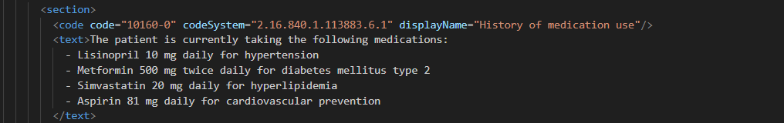
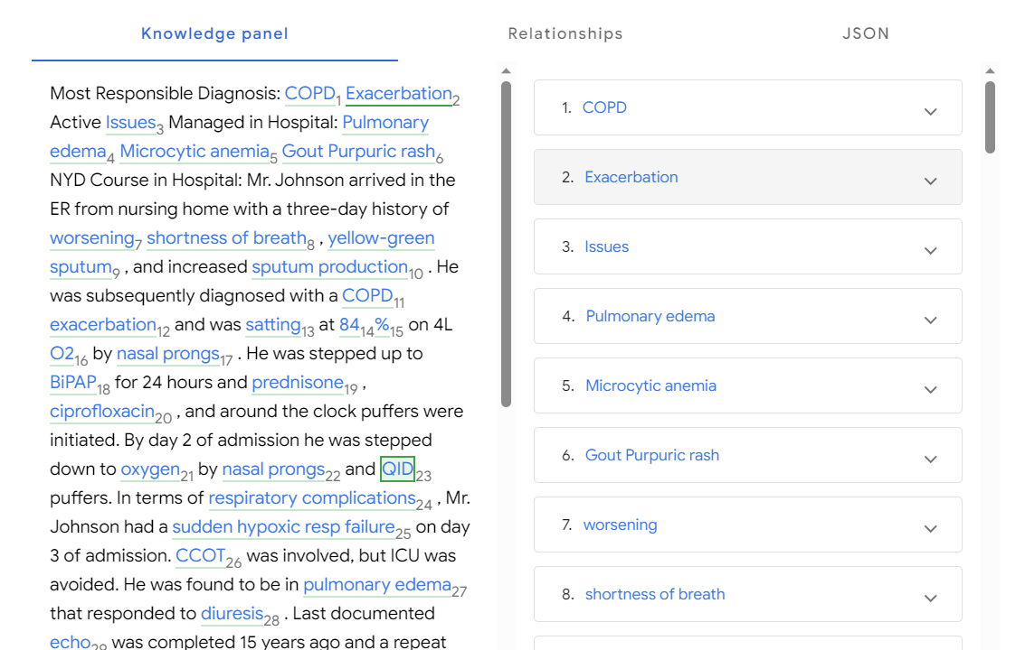
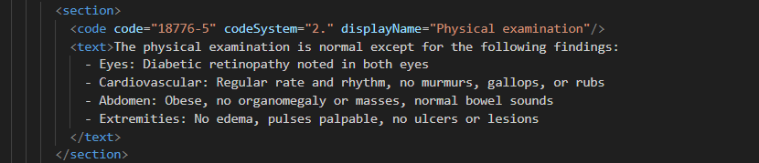
HEDIS Abstraction using NLP Co-Pilot
For Hybrid Measures, Abstraction team, assisted by co-pilot built using NLP, will extract the relevant information and store it in HEDIS Data Mart. This information is used in HEDIS measure calculation engine.
CCD (HL7 Format)
Entities Extracted from CCD Document

Slide 8
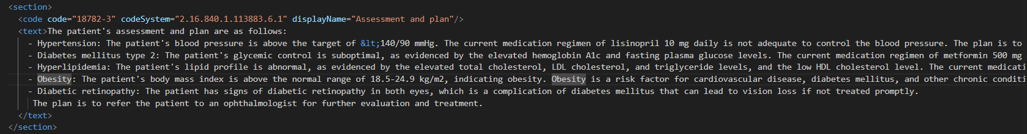



Automatic Digital Measure Calculation
NCQA Digital Quality Measure Definition
Automatic Gaps in Care Identification
FHIR Resource (Latest HL7 Format)
Clinical Quality Language is an expression language curated by HL7 that CMS, NCQA and others have adopted for digital quality measures. NCQA uses CQL to provide digital HEDIS measure content, including the NCQA Digital Content Services product line launched in early 2023.

Slide 9
Potential Next Steps – Proof of Value
1) | Data Acquisition, Processing and Storage | Data acquisition from EMR; converting from unstructured to structured; Storing the information in the HEDIS Datamart
2) | HEDIS measures calculation engine | CMS approved measure calculation engine and reporting
3) | Custom Analytics Solution | Targeting, Prioritization and reporting in Sharp Health Environment
4) | Outreach Solution | Email/sms outreach and analytics

Slide 10
Appendix

Slide 11
We drive higher value through our data led framework
Clinical + quality + cost outcome
EXL Framework
1
Push results into the existing EMR workflow so that providers can act at point of care
Outreach members with right message at the right time through member preferred channel (SMS, email, chat)
C
Outreach Strategy
Digital
Operations
2
Stratification
Stratification and modelling to identify providers and members for targeted outreach
Machine Learning
and Business Intelligence
Prioritization
Prioritization of HEDIS Gap closure to maximize impact on Star Rating through Simulation Dashboards.
3
Measure Numerator/Denominator
Calculate and store denominator and numerator for Quality Measures
Centralized Data Mart
Create centralized data mart using payor and provider data such as SdoH, claims, outreach information etc.
Data
Management
B
NLP Pipeline
Convert Unstructured data from Clarity to structured data and store it in Data Mart
Data
Aquisition
NLP Pipeline
4
A
Notes:
SPEAKER NOTES:
Data is the lynchpin to better business decisions. But extracting that data, organizing it, and converting it into insights and action is a challenge in a world of siloed information, incomplete customer views, and lagging indicators.
Without the right questions, the right approaches, and the right technology, data can give you some insights, but not the outcomes that are the difference between leading and lagging.
With deep experience in data management and advanced analytics, along with industry expertise in banking, finance, insurance, retail, media, and healthcare, we make data speak your language. We leverage technology as an amplifier, applying innovative approaches like machine learning, artificial intelligence, and automation to achieve the most advanced insights. And, with a scalable process and portfolio of accelerators that work with your existing infrastructure, we help you make every decision more informed, more quickly.
Whether we’re saving $1.5 billion in annual spend for a client by identifying attrition causes, increasing collections by 66% per hour for another, solving support call spikes, identifying revenue leakage, reducing overpaid medical claims, or offering legal support analytics, EXL has the capabilities in data management, sophisticated modeling, text and sentiment mining, and other proprietary methodologies to uncover deep insights and deliver high-impact solutions.
Examples of our industry recognition:
Customers’ Choice for 2 years in a row: Gartner Peer Insights "Voice of the Customer": Data and Analytics Service Providers 2020 & 2021
Visionary: Gartner Magic Quadrant for Data and Analytics Services 2021
Leader: Everest Group PEAK Matrix® for Advanced Analytics and Insights (AA&I) Service Providers 2021

Slide 12


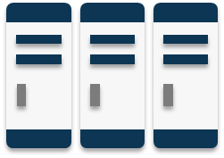








Our data management services start with a strong foundation
A
Enterprise Data Management
Expertise throughout the solution lifecycle
Data strategy
Data architecture
Data engineering
Data operations
Data Strategy
Define goals, vision, roadmap and artifacts for an organization to manage their data as a strategic asset
End-to-End QA & Testing
Data Governance
Enable a program to ensure high quality data is available on-demand. Includes metadata management & data standardization
Data Platform
Modernization
Data Engineering &
Virtualization
Master Data Management
Data Quality
Evolve legacy data ecosystems into flexible architectures to support unstructured and real-time data. Includes Cloud, Big Data and Automation
Enable seamless data movement between disparate applications / systems in near/real time
Aggregate “siloed” data and integrate it into the client’s operational systems
Evaluate data in operational and decision-making contexts and install processes to improve and maintain health of data
Data Architecture
and Modeling
Blueprint of models, policies and standards that govern which data is collected; how it is stored, arranged, integrated, and put to use, to enable data-driven decision-making across the enterprise
Technology and Data Operations
Data Security & Privacy

Slide 13
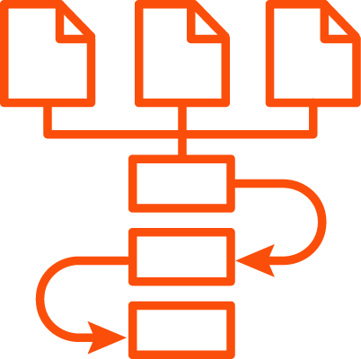
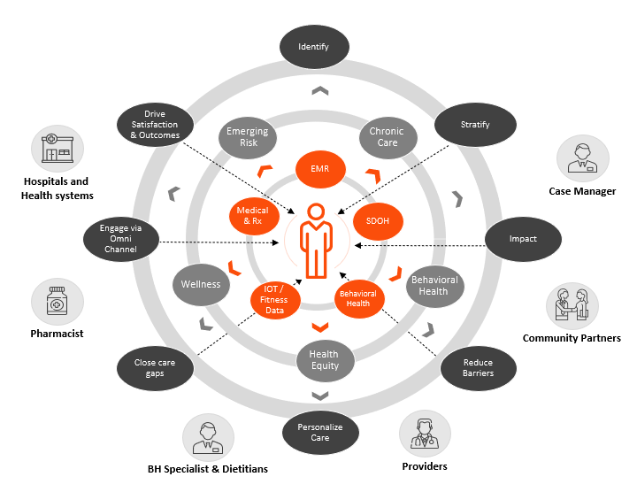


EXL Delivery Framework
A
Enterprise Data Management
Data Foundation & Processing
Data Sources
Strong data foundation
Data Enrichment & Interoperability
End user experience
Eligibility
Lab &
Biometric
CMS
Patient 360° View
Flexible & Customizable
Security Enforcement at various infrastructure, application and user level
Analytics & Reporting
Population & Financial Health
Provider Performance
Quality Reporting
Health Equity
Outcomes & ROI Reporting
Value Based Care
Standard Cohort Analysis
Action-Oriented Insights using Intelligent Automation & AI capabilities
EMR
Medical
Claims
Care
Management
Advanced Analytics Models & NLP
Clinical User
HIE
Data acquisition
Clinical Library/Benchmark
Rx
Claims
EMR &
HIE
Data
Surveys
ADT
Financial User
SDOH
Data
Third
Party
Data
Data quality
Device
Vendor Integration, Interoperability & APIs
Remote
Monitoring
Data implementation
Consumer 360 View
Patient Engagement
Well defined structure and transparent government processes
Periodic contractual reviews, automated SLA tracking, defined escalation protocols
Tools, automation and process for incident management , audit checklists
Organizational and Governance Structures
Security & Monitoring & Audit Control
13
Notes:
Smita

Slide 14
Thank you

